Slide 1
Emergency Code Training
for
Students on Learning Placements at KGH

Slide 2
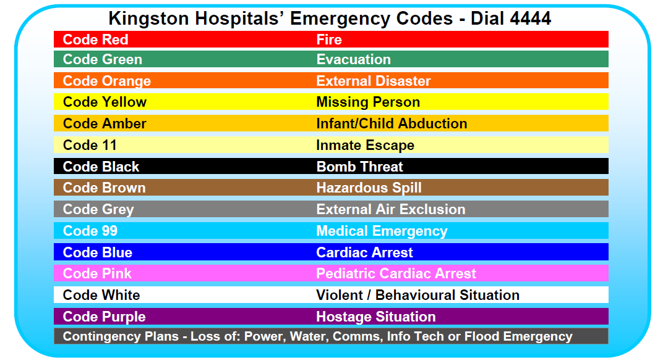
Emergency Code Training
For Students on Learning Placements at KGH

Slide 3
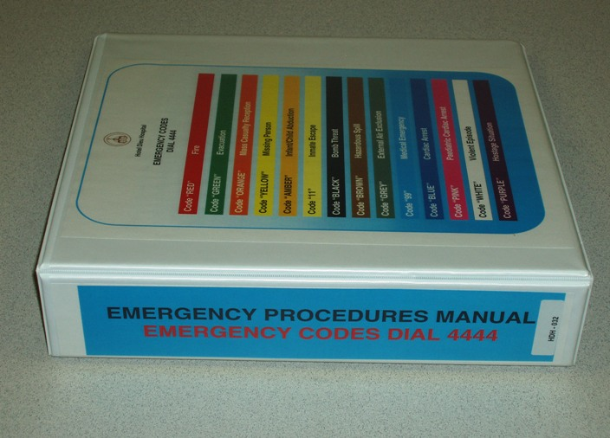
Emergency Procedure Manual
This training is intended to introduce you to some of the emergency codes you may hear while at KGH.
All of the codes including detailed plans for response and recovery procedures are outlined in the Emergency Procedures Manual.
These manuals are available on all units/departments , on the KGH intranet, and in all off site KGH buildings

Slide 4
Important Phone Numbers
In the Event of Any Emergency:
Call Switchboard @ 4444 to report the emergency.
Give specific information; your name, location and the nature of the emergency.
Never dial 0, as you could be put on hold.
For Day-to-day Security Requests:
Call the Security Control Centre (613-549-6666) ext. 4142

Slide 5
Procedures to Follow in the Event of a FIRE

Slide 6
Procedures to Follow in the Event of a FIRE

Slide 7
Procedures to Follow in the Event of an EVACUATION
A Code Green may be called in the event of a fire however it may be used at other times as well where an emergency requires evacuation of one or more areas of the hospital/facility. There are two levels of Code Green that may be implemented during an Emergency.
“Code Green – Cautionary” will be used to inform staff to start preparing for evacuation. This would be followed by overhead announcements with specific instructions for the affected area.
“Code Green – Stat” will be used for emergencies requiring immediate evacuation.

Slide 8
Procedures to Follow in the Event of an EVACUATION

Slide 9
Procedures to Follow in the Event of an EVACUATION
Defend in Place
The building is constructed to provide protection which allows for defending in place when you can’t evacuate.
It is dangerous to enter hallways, or take stairwells, that are filled with smoke. If necessary, you can take shelter in an enclosed room when you take adequate precautions.
Close the door and block the gap between the door and the floor to stop smoke from getting in. If possible use wet towels or blankets.
If the window in the room opens, use an item of clothing to signal for help.

Slide 10
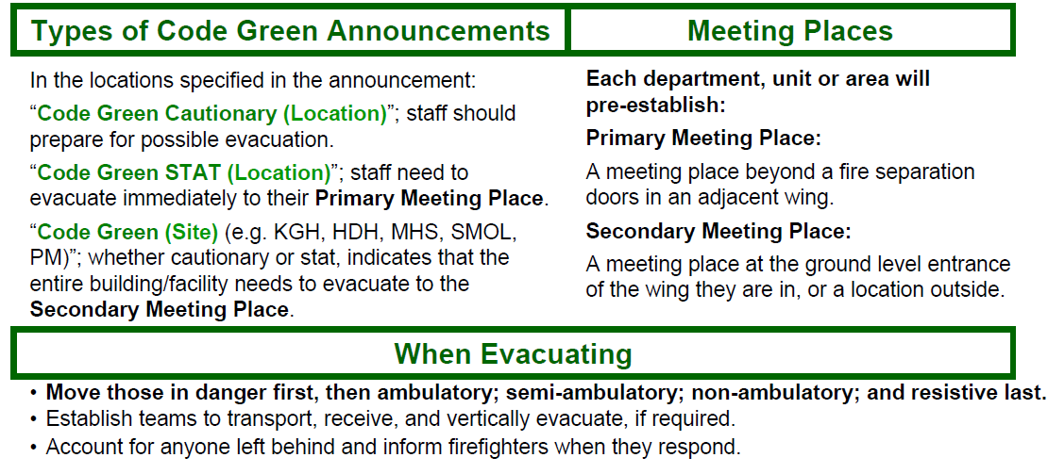
Procedures to Follow in the Event of an EVACUATION

Slide 11
Procedures to Follow in the Event of an EVACUATION
During an EVACUATION always evacuate the easiest people first:
Ambulatory patients (those that can walk on their own) are easiest.
Semi-ambulatory patients are harder to evacuate, and non-ambulatory patients will likely require more than one person to evacuate them.
Resistive patients should be left until last. You can move several people who want to leave in the same amount of time spent struggling with someone who doesn’t.

Slide 12
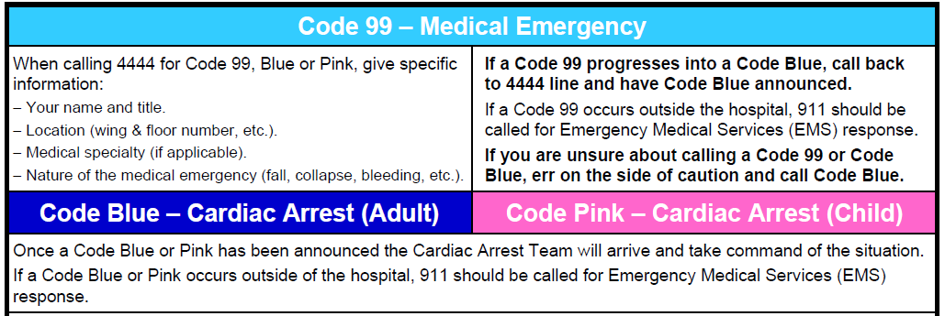
Emergency Codes – Quick Reference
Notes:
Hide these codes?

Slide 13
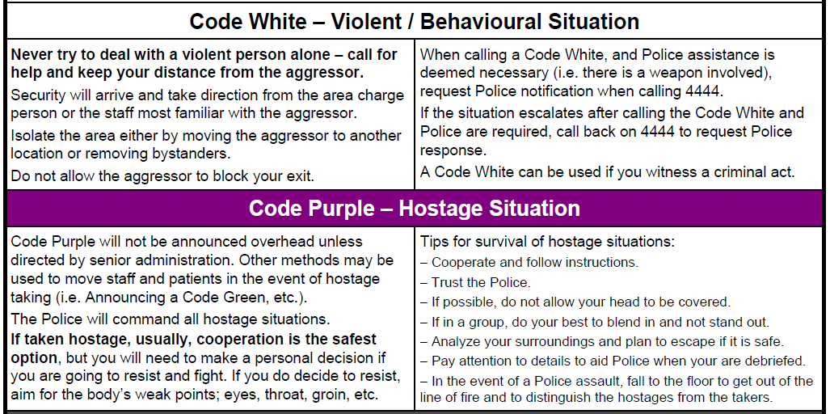
Emergency Codes – Quick Reference

Slide 14
Emergency Codes – Quick Reference

Slide 15
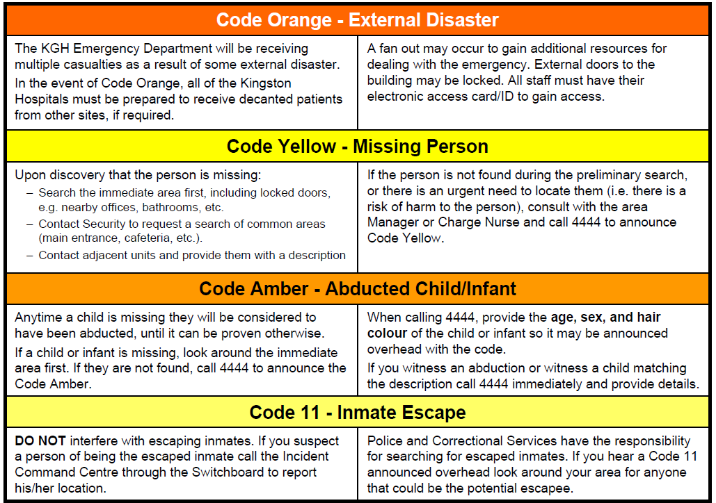
Emergency Codes – Quick Reference

Slide 16
Should you have any questions about KGH’s Emergency Response Codes or Response Plans, please speak with your instructor, or contact Security Services x4142.

Slide 17
Welcome to KGH!
We hope you have a safe, rewarding, and enjoyable learning experience.

